Slide 1


Slide 2
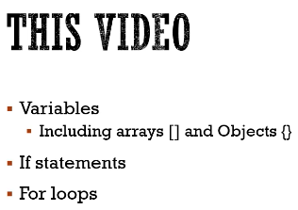

Slide 3
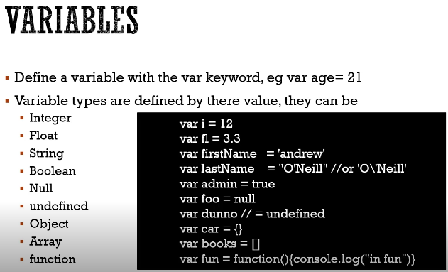

Slide 4
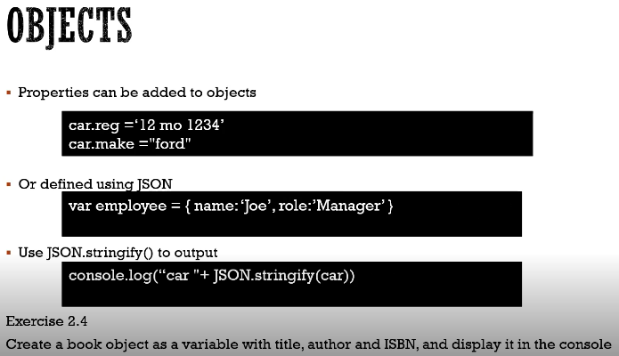

Slide 5
My9javascript14.html - on console: book is {object object}. Book is object object that does not output very nicely. That sometimes happens if you add an object to the end of a string. So the solution to that is to use JSON not stringify, and you pass in the object you want to stringify.
My9javascript15.html - nice on console

Slide 6
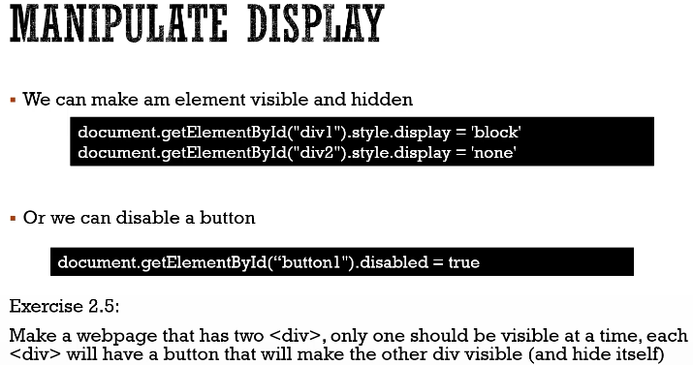

Slide 7
My9javascript16.html - show div 1 blue
My9javascript17.html - show div2 red when u click button, but when we click button again, nothing else happens. So
My9javascript18.html -should interchange div 1 and div2 whn u click

Slide 8
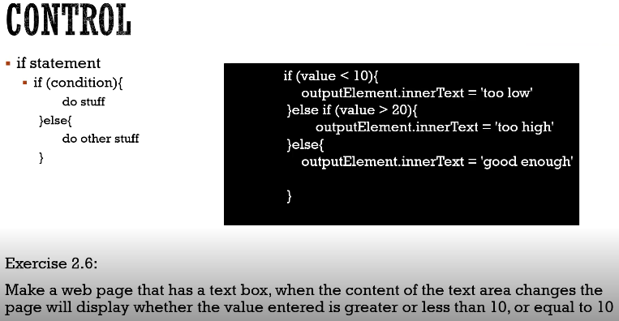

Slide 9
My9javascript19.html - nothing happens when u type in numbers
My9javascript20.html - will do if statement

Slide 10
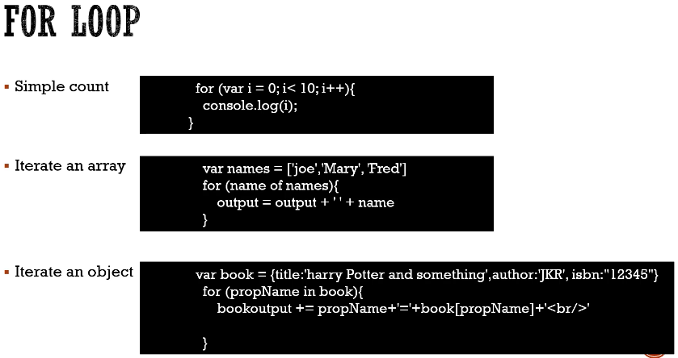

Slide 11
For loops are ways of iterating through either numbers, arrays or objects.
So in this case simple count. This for loop will count from zero to 9, starts off initialises it to be 0 then cheques if I is less than 10. If it is, it outputs the value of I, so I I 0, so will output 0
when it's done. It's that once it's done that it goes up and increments I it's I equal 1, I equal to I + 1.
So the I does cheques if it's less than 10 so I is now one and will then do a console log with one so then output 01 and it will keep repeating this I being 2 less than 10. Yes output 2 keeps repeating this until I is no longer less than 10. So when I is equal to 10 it doesn't execute this line. So that means with output 012345678 and 9:00 whatever number you put here 1 less than that number.

Slide 12
an array via names which has got three strings, Joe, Mary and Fred and we use a four loop to iterate through it for name of names. This will go through the array names and take out one of the elements at a time and store it in the variable called name. So what we've done here is we're making a big long string called output.
Output would be equal to whatever output was plus a space plus the name.
If you wanted to, you could then move the output to a division and so I would display the contents of the array.

Slide 13
an array via names which has got three strings, Joe, Mary and Fred and we use a four loop to iterate through it for name of names. This will go through the array names and take out one of the elements at a time and store it in the variable called name. So what we've done here is we're making a big long string called output.
Output would be equal to whatever output was plus a space plus the name.
If you wanted to, you could then move the output to a division and so I would display the contents of the array.

Slide 14
If you use the keyword in you can iterate through all the properties of an object.
So here's an example where we have var book which is a title, author and ISBN and then we say for prop name in book. So that will go through the object book taking out all the property names title, author and ISBN and allow us then to access the contents of the book. So I have book output plus equals that will basically add to the book output.
Property name so that would be title plus an = so equals and then the value of that property name So that would be Title equals Harry Potter and something and then put in a line break
and then author is JKR and then ISBN equals 12345.

Slide 15

outputs the contents of the array into some kind of div

Slide 16
My9javascript21.html - output in console 0-49
My9javascript22.html - outputs the contents of the array into some kind of div – on browser joe mary fred, on console 1-9, Look at elements (inspector) div- joe, break, mary, break

Slide 17
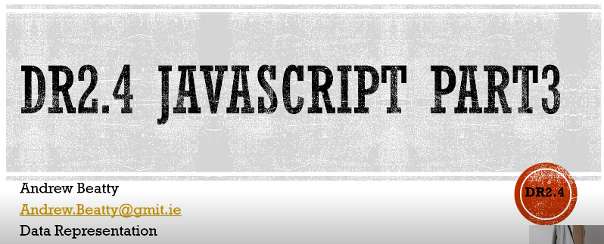

Slide 18
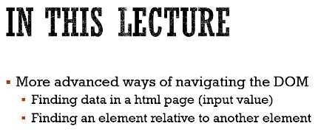

Slide 19
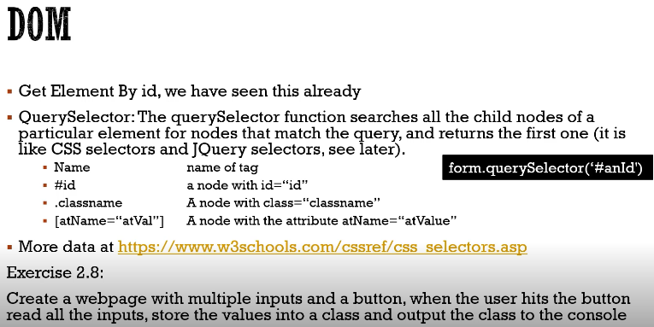

Slide 20
My9javascript23.html - but if u click go, nothing happens bc no function. Console says Do form is not defined
My9javascript24.html - console will say in do form
My9javascript25.html - store inside some object (type input and click go)

Slide 21
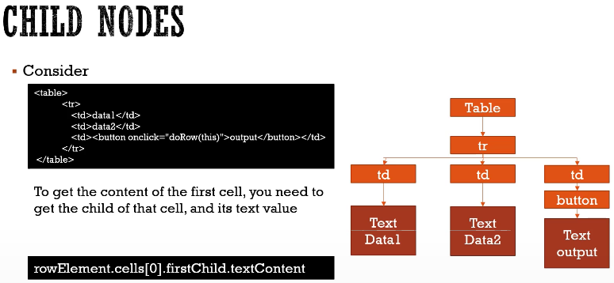

Slide 22
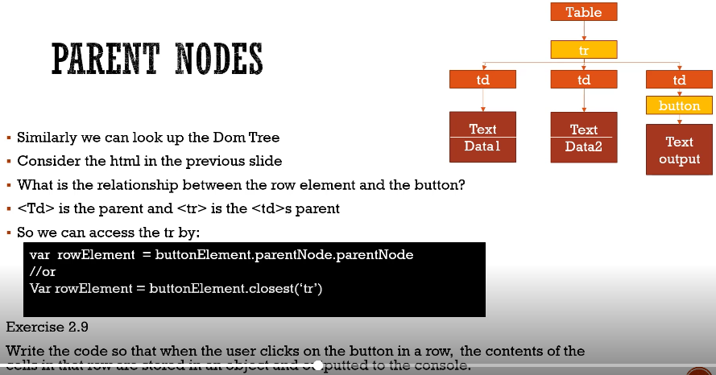

Slide 23
My9javascript26.html - you can see content of cells
My9javascript27.html - change content of cells

Slide 24
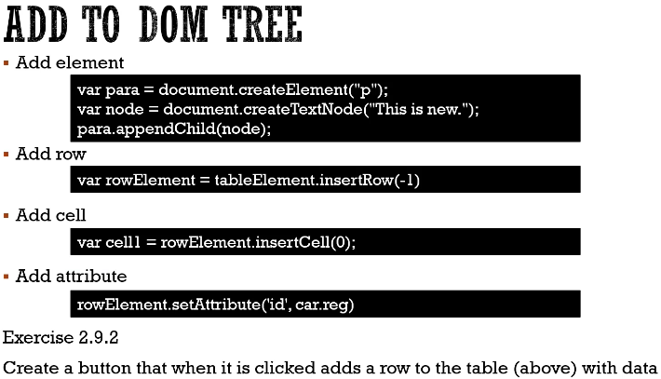

Slide 25
My9javascript28.html - created create row button, but no function
My9javascript29.html - create function – and will create new row when u click create Row

Slide 26
My9javascript21.html -

